Slide 1
Residue Feature/ Connection Feature Generation for GCNN
Samuel Stentz

Slide 2
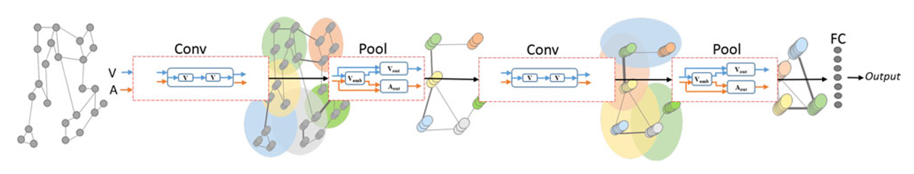
What Does a Graph Convolutional Neural Network (GCNN) Take as an Input?
It depends! GCNN is really a catch all term for neural networks that start with some graph structure, do a “convolution” (spectral or spatial) followed by a pooling step, and end with a list of nodes.
These Nodes can then be fed into a traditional NN
Traditional NN
Result
Multiple Convolution and Pooling Steps
1D Layer of Nodes
Graph Input
[1]

Slide 3
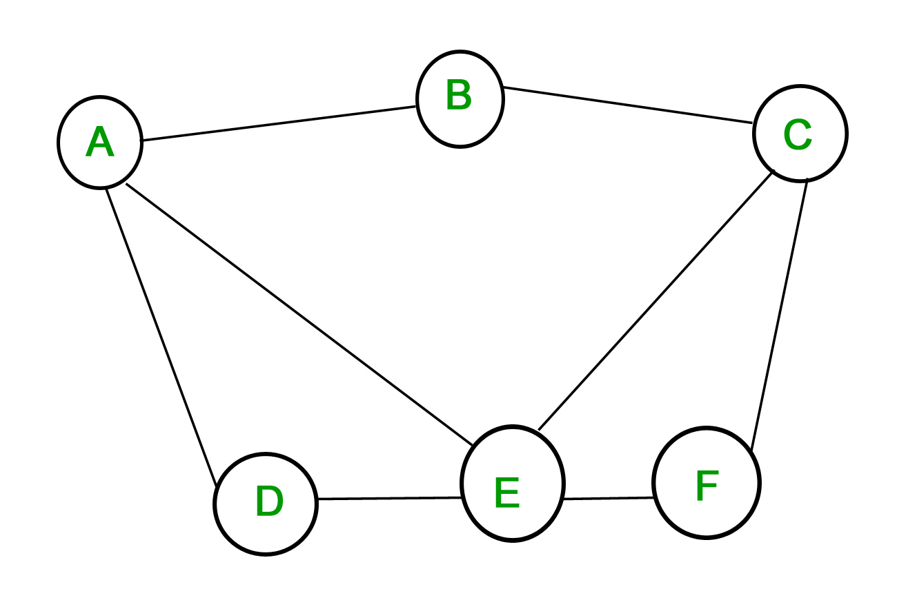
Graph Definition
A way of modelling elements and their interactions
Nodes/Vertices: for our graph are a residue/AA
All nodes and features denoted as V
Connection/Edge: for our graph relations between residues
Adjacency matrices are ways to represent all edges for one relation (Denoted as A)

Slide 4
Defining That Input Graph
Some GCNN’s require that the input graphs be homogenous (i.e. connections between nodes are identical), have only one/zero features per connection, or have only one feature per node.
To model protein-protein interactions at the residue level we would like to have:
Easy: multiple connection features (two body interaction energies, geometric distance)
Difficult: multiple node features (amino acid type, energy terms, etc.)

Slide 5
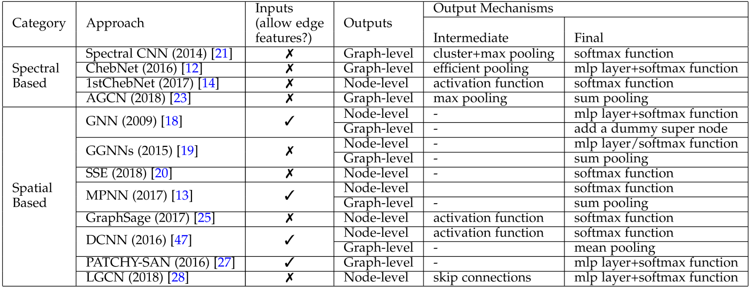
Unfortunately…
Lots of GCNN fail to incorporate edge (or connection) features at all, and those that do generally only allow one. We will have to seriously consider this factor when building/implementing our model.
[2]

Slide 6
Solution (Maybe?)
To solve this issue we may just consider using only one adjacency matrix (either euclidean distance or total energy interaction) and simply assume other more complicated relationships will be left to the model.
ConvNet ^{[3]} is a spectral approach that is open source which could handle this analysis. It consistently performs well and is well established. It accepts one dimension of connections/edge weights.
We can attempt to build an in house model based on [1],[2] which handles multiple edge features. I can try to do this, but can’t make any promises (some of the spatial convolutions will be difficult to incorporate into packages such as TensorFlow/PyTorch)

Slide 7
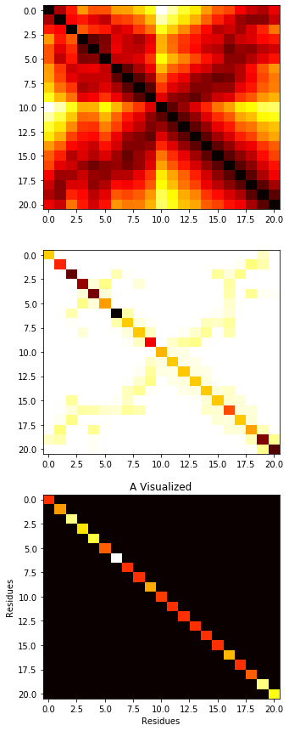
Edge Features
Euclidean Distance Adjacency Matrix
Due to previously stated issues the options are:
An adjacency matrix of Euclidean distance
An adjacency matrix of Rosetta/Amber interaction energy
Many adj. matrices for Euclidean distance and multiple score terms (Requires an in house model)
Score Term Adjacency Matrix
Score Term Adjacency Matrix

Slide 8
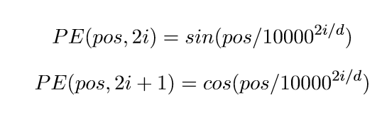

Node Features
#21-24
pos: primary sequence index
i: encoding dimension
d: number of dimensions (4)
#1-20: one hot (1 if true, 0 otherwise) vectors representing amino acid type
#21-24: Sinusoidal positional encoding
#24: Normalized Distance from alpha-Carbon of residue to COM of protein
#25: Cosine Similarity with respect to alpha-Carbon of COM of protein and COM of sidechain
#26-28: Rosetta one body score terms (fa_sol, lk_ball_wtd, p_aa_pp)
#29: one hot vector representing member of substrate/ member of protease
#24
Protein’s COM
$$θ$$
#25
Residue’s Ca
Residue’s Sidechain COM
[3]https://www.biorxiv.org/content/10.1101/610444v1.abstract

Slide 9
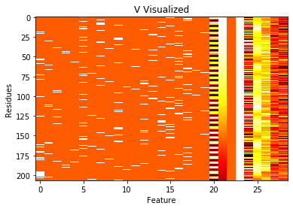
Node Feature Matrix for Protease/Substrate Complex

Slide 10
Determining Which Residues to Model
Most models require a fixed number of nodes or residues. To handle this we thought of a few options
Use only the substrate residues. Will likely do very poorly if we hope to train the model on different proteases (assuming the proteases have different specificity profiles which is the point) as interactions between the substrate and protein will not be directly contributed.
Use all of the substrate and all of the protease. This will be an issue if we try to apply our model to different sized proteases, which we would like to do.
Choose some sort of metric like k-nearest residues to substrate, highest contact area with substrate, etc., to select a fixed number of protease residues. Joey had some good ideas on possibilities for this.

Slide 11
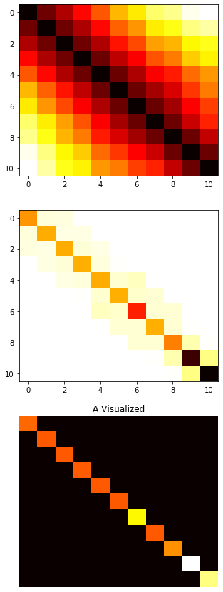
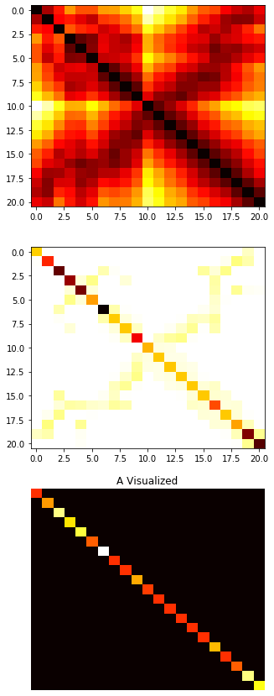
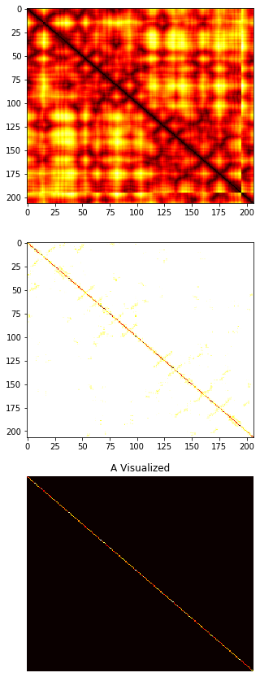
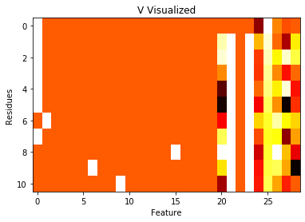
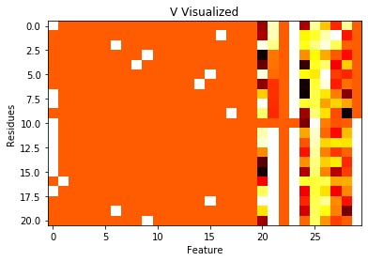
Quick Look at Three Options Visually
1) Substrate Alone
2) Entire Complex
3) Substrate and Interface based on k-nearest (k = 10)
Adjacency Matrix Node Features
Adjacency Matrix Node Features
Adjacency Matrix Node Features

Slide 12
Conclusions
Lots of tuning on both our graph input and model will need to be done.
Any ideas for good potential features I could incorporate is always appreciated

Slide 13
Citations
Such, Felipe Petroski, et al. "Robust spatial filtering with graph convolutional neural networks." IEEE Journal of Selected Topics in Signal Processing 11.6 (2017): 884-896.
Wu, Zonghan, et al. "A comprehensive survey on graph neural networks." arXiv preprint arXiv:1901.00596 (2019).
Defferrard, Michaël, Xavier Bresson, and Pierre Vandergheynst. "Convolutional neural networks on graphs with fast localized spectral filtering." Advances in neural information processing systems. 2016.
Zamora-Resendiz, Rafael, and Silvia Crivelli. "Structural Learning of Proteins Using Graph Convolutional Neural Networks." bioRxiv (2019): 610444.

